Slide 1
NCICB Common Security Module
CSM Presentation
03/03/2005

Slide 2
Introduction
Government Team
  Peter Covitz covitzp@mail.nih.gov
  Avinash Shanbhag shanbhak@mail.nih.gov
Ekagra Team
  Kalpesh Patel (Program Manager) patelk@mail.nih.gov
  Vinay Kumar (Project lead) kumarvi@mail.nih.gov
  Brian Husted ( Co-Architect & QA) bhusted@ekagrasoft.com
  Kunal Modi (Senior Developer) modik@mail.nih.gov
  Eric Copen (Test Engineer & QA) copene@mail.nih.gov
The Documentation Location on the net:
  http://ncicbintra.nci.nih.gov/ncicb_common/#security
Notes:
Kalpesh

Slide 3
Agenda
Project Overview
Services Offered in caCore 3.0 Release
Overall Architecture
Authentication
Authorization
User Provisioning Tool
Reference Implementation
Notes:
Kalpesh

Slide 4
Project Overview – Motivation
Eliminate duplication of effort and resources
Standardized mechanism for common security needs
Compliance with emerging industry-wide security standards
Notes:
Kalpesh

Slide 5
Project Overview - Vision
Common Security Module (CSM) was perceived to provide a common infrastructure and mechanism to cater to security needs for all NCICB applications
To provide a easy to adapt and integrate module
To provide a module complying to latest industry security standards and technologies
Notes:
Kalpesh

Slide 6
Project Overview - Scope
Scope for CSM caCore 3.0 release was decided in consensus with the SWG
Features in current release
  Authentication
  Authorization
  User Provisioning Tool
  Reference Implementation
Total 38 use cases!
Notes:
Mention that all the slides following this are based on this limited scope as decided in SWG meetings for caCore 3.0 release

Slide 7
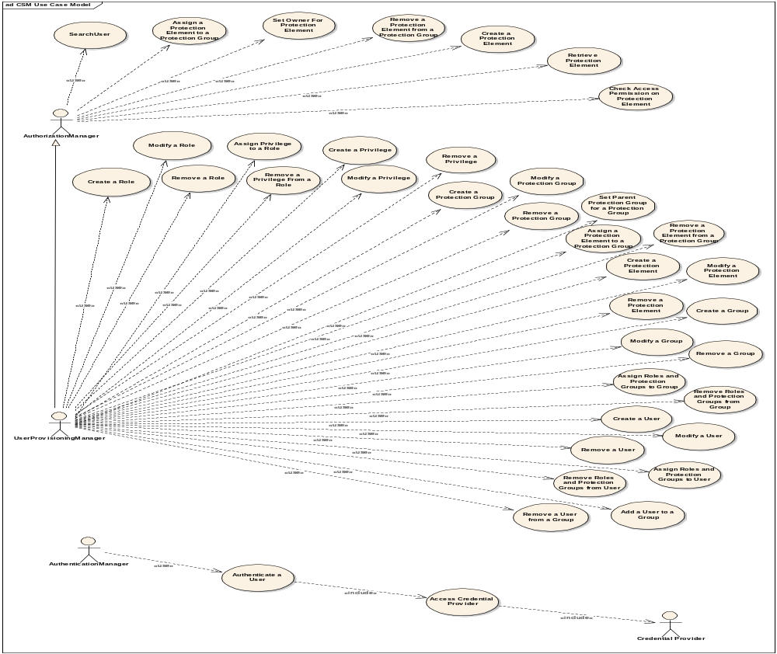

Slide 8
CSM Approach
Open Source Technology – based on standard caCORE stack
Java Authentication and Authorization Service (JAAS)
  Standard Java APIs
Authentication
  Authentication against existing credential providers
  Easy integration with existing applications
Authorization
  Configurable granularity for protection
    Coarse or Fine-grained security
  Management of authorization meta model via UI
Reference Implementation

Slide 9
High Level Architecture for Phase I
Credential Providers
Application server
RDBMS
LDAP
Application XYZ
Authenticate
Common
Authorization
schema
JAAS
Authenticate
Authorize
Security module
Authorize
User
Provisioning
Web
interface
Web server
Application
server
User
Provisioning
application
Notes:
Vinay

Slide 10
CSM Components
CSM API jar (java archive)
  Authentication
  Authorization
User Provisioning Tool (web application)
  Provisioning of Authorization Data
Reference Implementation
Notes:
Mention about the services offered by each component

Slide 11
CSM API Integration
Distributed in form of jar files
Minor coding required to integrate the API services
Easily configurable to be able to connect to the authorization database and authentication credential providers
Notes:
Kalpesh

Slide 12
Authentication Service
Verify user credentials against configured credential providers
Notes:
Kalpesh

Slide 13
Authentication Service
JAAS based service
Currently supports RDBMS and LDAP/LDAPS based credential providers for authentication
Supports NCI e-directory
Notes:
Kalpesh

Slide 14
Working with Authentication
Include the CSM API jar in the classpath
Setup the configuration files to point to the credential providers
Use Authentication Manager and call the service
ApplicationSecurityConfig.xml
login-config.xml

Slide 15
Code Example - Authentication
try {
AuthenticationManager authenticationManager = SecurityServiceProvider.getAuthenticationManager(“caArray”);
boolean loginOK = authenticationManager.login(“kpatel”, “12321” );
}
catch (CSException cse){
System.out.println("ERROR IN LOGIN");
}
Notes:
Kalpesh
Talk about Subject

Slide 16
Authorization Service
What is authorization?
Provides declarative authorization schema
Web based tool to provision authorization metadata
Runtime Java API to control access based on the authorization metadata
Notes:
Kalpesh

Slide 17
Authorization Service – Concepts
Entities
  Application
  User
  Group
  Protection Element
  Protection Group
  Role
  Privilege
Notes:
Kalpesh

Slide 18












Authorization Model
JBoss
Csmapi.jar
Notes:
Kalpesh

Slide 19
Authorization Service – Security Types
Role Based Security
Group Based Security
Object Level Security
Attribute Level Security
A Salary may be one of the attribute of the employee object.
e.g. Only a user having HR_Manager role can change that attribute. In this case not even the owner of that record can change that attribute.
A employee record is an object.
e.g. Only certain users/groups have HR_Manager role for this object. Also employee himself will have an “Owner” role for that record
A group of users can assume a role for a protection group.
e.g. A group can assume HR_Manager role for a protection group containing all employee records.
A user assumes a role for a protection group.
e.g. A user can assume HR_Manager role for a protection group containing all employee records.
Notes:
Kalpesh

Slide 20
Authorization Service Provided
Create Protection Elements
Assign Protection Elements to Protection Group
Assigning Owners to Protection Elements
Checking Access Permissions
Notes:
For further details refer to Javadocs

Slide 21
Authorization Service – Deployment Modes
Standalone deployment
  Localized deployment of authorization schema
Shared deployment
  Using one authorization schema for multiple applications (e.g. C3PR & caMatch using one authorization schema)
Notes:
Kalpesh

Slide 22
Working with Authorization
Include the CSM API jar in the classpath
Setup the configuration files
Use Authorization Manager and call the service
There are 21 authorization related operations which can be used at runtime
ApplicationSecurityConfig.xml
hibernate.cfg.xml

Slide 23
Code Example - Authorization
try {
AuthorizationManager authorizationManager = SecurityServiceProvider.get AuthorizationManager (“c3pr”);
boolean hasPermission = authorizationManager.checkPermission(“user name”, “protection element”, “privilege name” );
if ( hasPermission ){
//do privileged
}
}
catch (CSException cse){
System.out.println("ERROR IN Authorization");
}
Notes:
Kalpesh

Slide 24
UPT - Authorization Data Provisioning
Web based tool to provision the authorization metadata for an application
Notes:
Kalpesh

Slide 25
UPT - Authorization Data Provisioning
Modes of Deployment of tool
  Single Installation Single Schema used by multiple applications
  Single Installation – but each application has its own Schema
  Local Installation Local Schema for each application
App 1
UPT
App 1
UPT
UPT
App 1
Authorization database for APP 1
Common authorization
Database
Authorization
Database
App 2
Common authorization
Database
App 2
Notes:
Kalpesh

Slide 26
Reference Implementation
A small prototype application to highlight the following
  Integration of security API
  Usage of security API
  Configuration of security API
Notes:
Kalpesh

Slide 27
Reference Implementation
RI is a small company HR management web application.
12 use cases that define the functionality of the system
It will have three roles
  Employee
  HR_Manager
  Project_Manager
It will show how CSM functionality can be used to protect the data at different levels
Notes:
Kalpesh

Slide 28
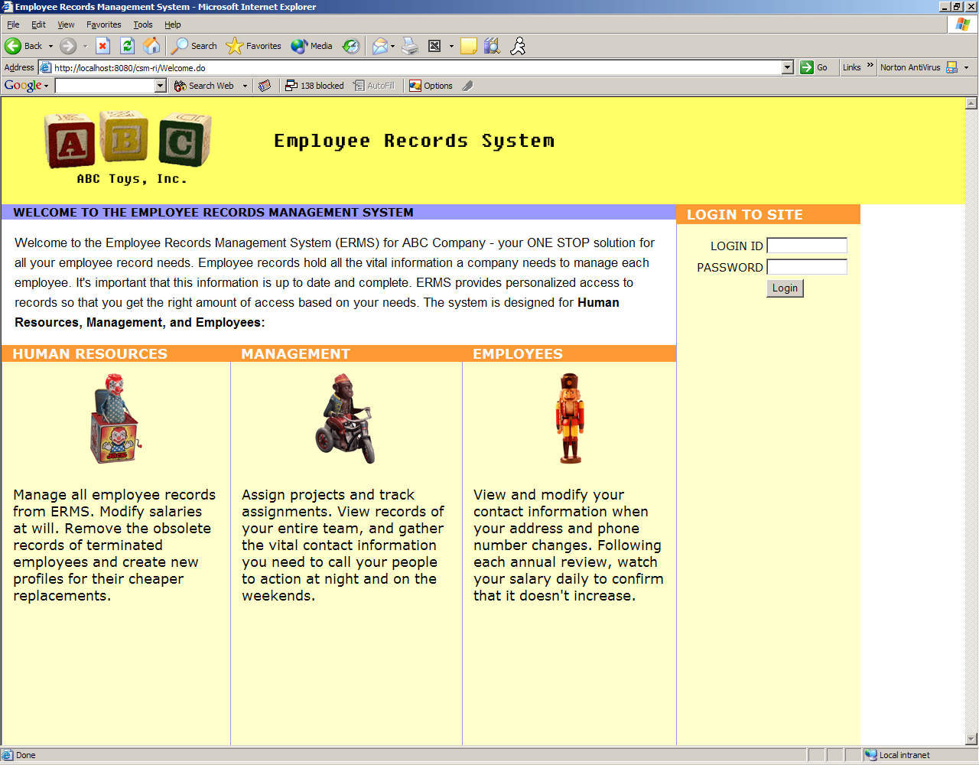
Screen Shot - RI

Slide 29
Integration with C3PR
C3PR uses only the Authorization Service provided by CSM
UPT tool to input the C3PR authorization data in the common database
Integration of C3PR with CSM was smooth
  Took total 1 hour of configuration to integrate
  Total took 1 day due to access issues
  C3PR in progress of implementing CSM authorization APIs in their code
Notes:
Mention time

Slide 30
Project Documentation
Requirements and Design in EA
Test plans in EA
CSM Guide for application developers
  Multiple deployment models
  Configuration & Integration for Authentication
  Configuration & Integration for Authorization
  Authorization Meta data set up using web interface
Reference Implementation (RI)
  Conceptually similar to Pet Store
  Full and working application that demonstrates how to use CSM functionality
    Documented business scenario (HR system)
    Demonstration of the implementation of these requirements using CSM
    Reference Implementation Guide
      With example code snippets
    Documented best practices for CSM
UPT user guide

Slide 31
Future of Authentication & Authorization
Generalized and SOA based

Slide 32
TARGET ARCHITECTURE
Authentication
Credential providers
LDAP
RDBMS
Others..
Authenticate
authenticate
Application A
Security Service
csmapi.jar
Application B
(using
Web Services)
Authenticate (SOAP)
Notes:
Vinay

Slide 33
TARGET ARCHITECTURE
Authorization
Application specific
Authorization schema
(role to objects mapping)
Application A
A
Application C
(using only
Web Services)
Security Service
csmapi.jar
XML
Common
Authorization
schema
Application B
(using
Web Services &
native calls)
B
Xml Authorization Schema
Application server
User
Provisioning
Web
interface
Web
server
User
Provisioning
application
(User to role mapping)
Notes:
Vinay

Slide 34
Future Direction
March
  Finalize Scope for Next release
Need input from each team in prioritization
Potential Priorities
  caBIG integration with grid security
  CSM under SOA
    Security Framework to be available as a Web Service which can be access using client APIs or direct SOAP calls
  Single Sign-On
  PKI Integration
  Project Liberty alliance & Shibboleth integration
  Regulatory Compliance – HIPPA & CFR 21 part 11
Notes:
Kalpesh

Slide 35
Questions ?....

